Slide 1
Map, Food, & Smiles Project topic Hung-Cheng Chang, 張宏正

Slide 2

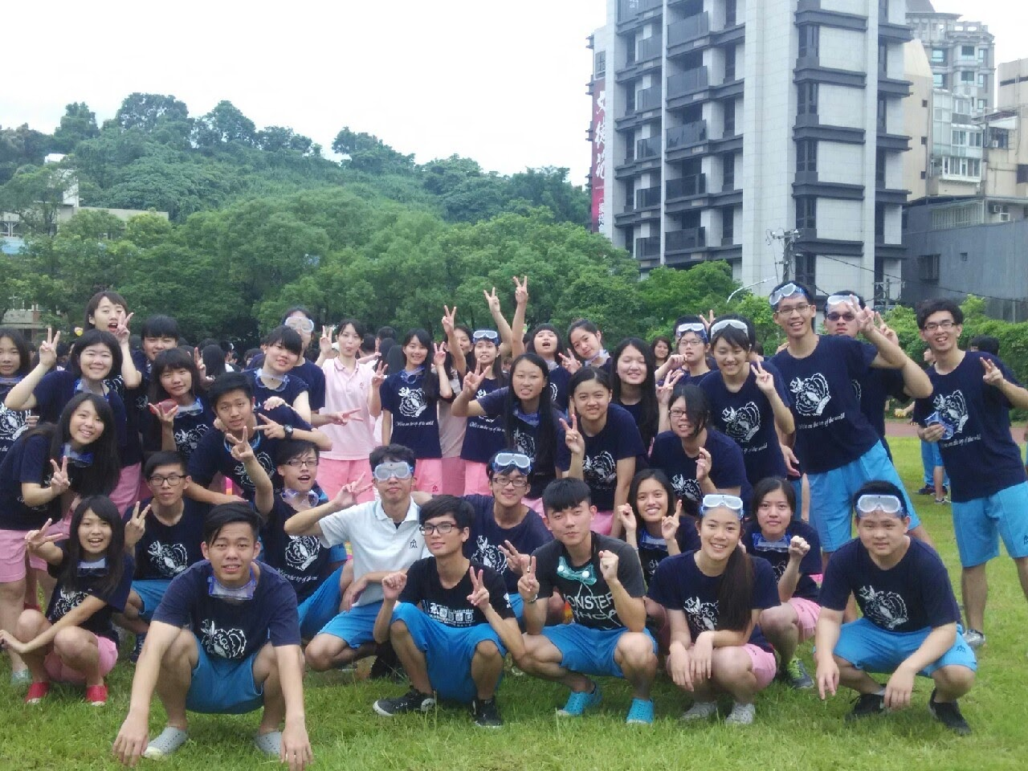
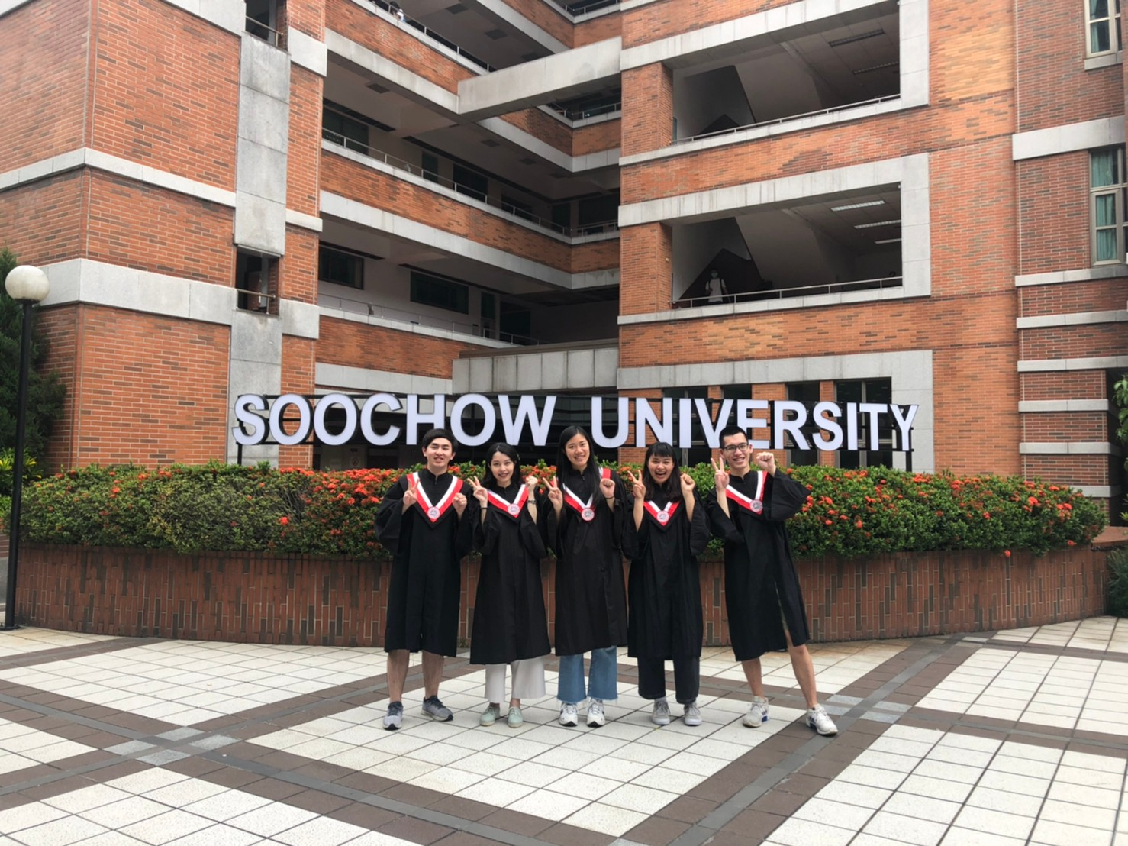
Maps
2013-2016
Neihu High School
(Taipei)
2016-2022
Soochow University
(Taipei)
2024-
National Yang Ming
Chiao Tung University

Slide 3
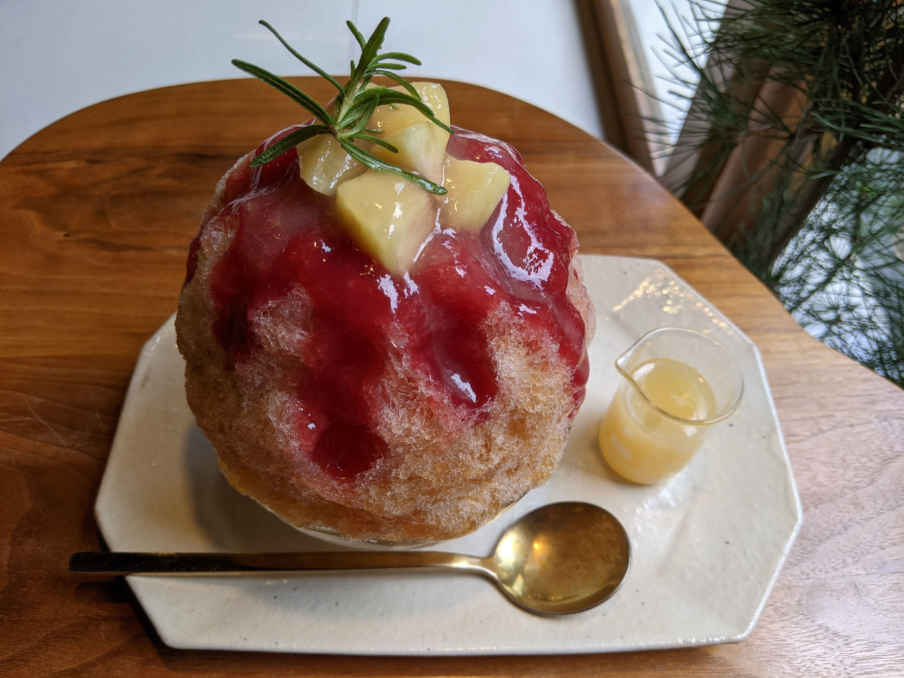

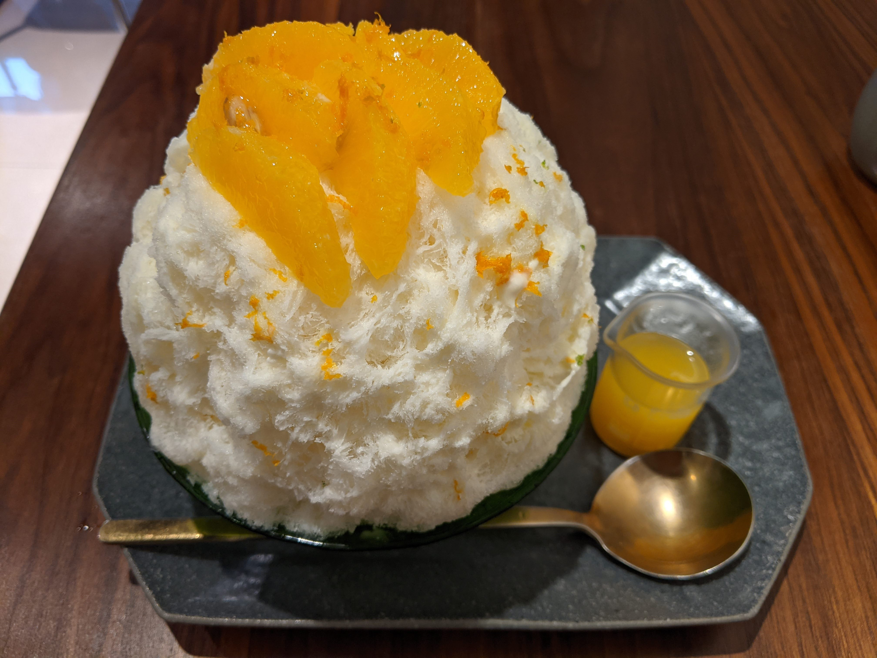
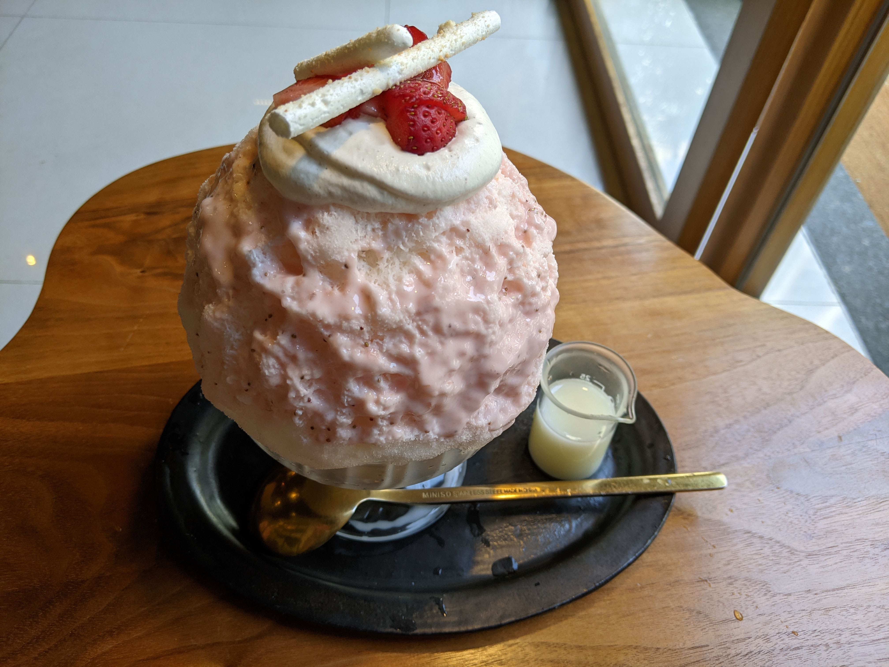
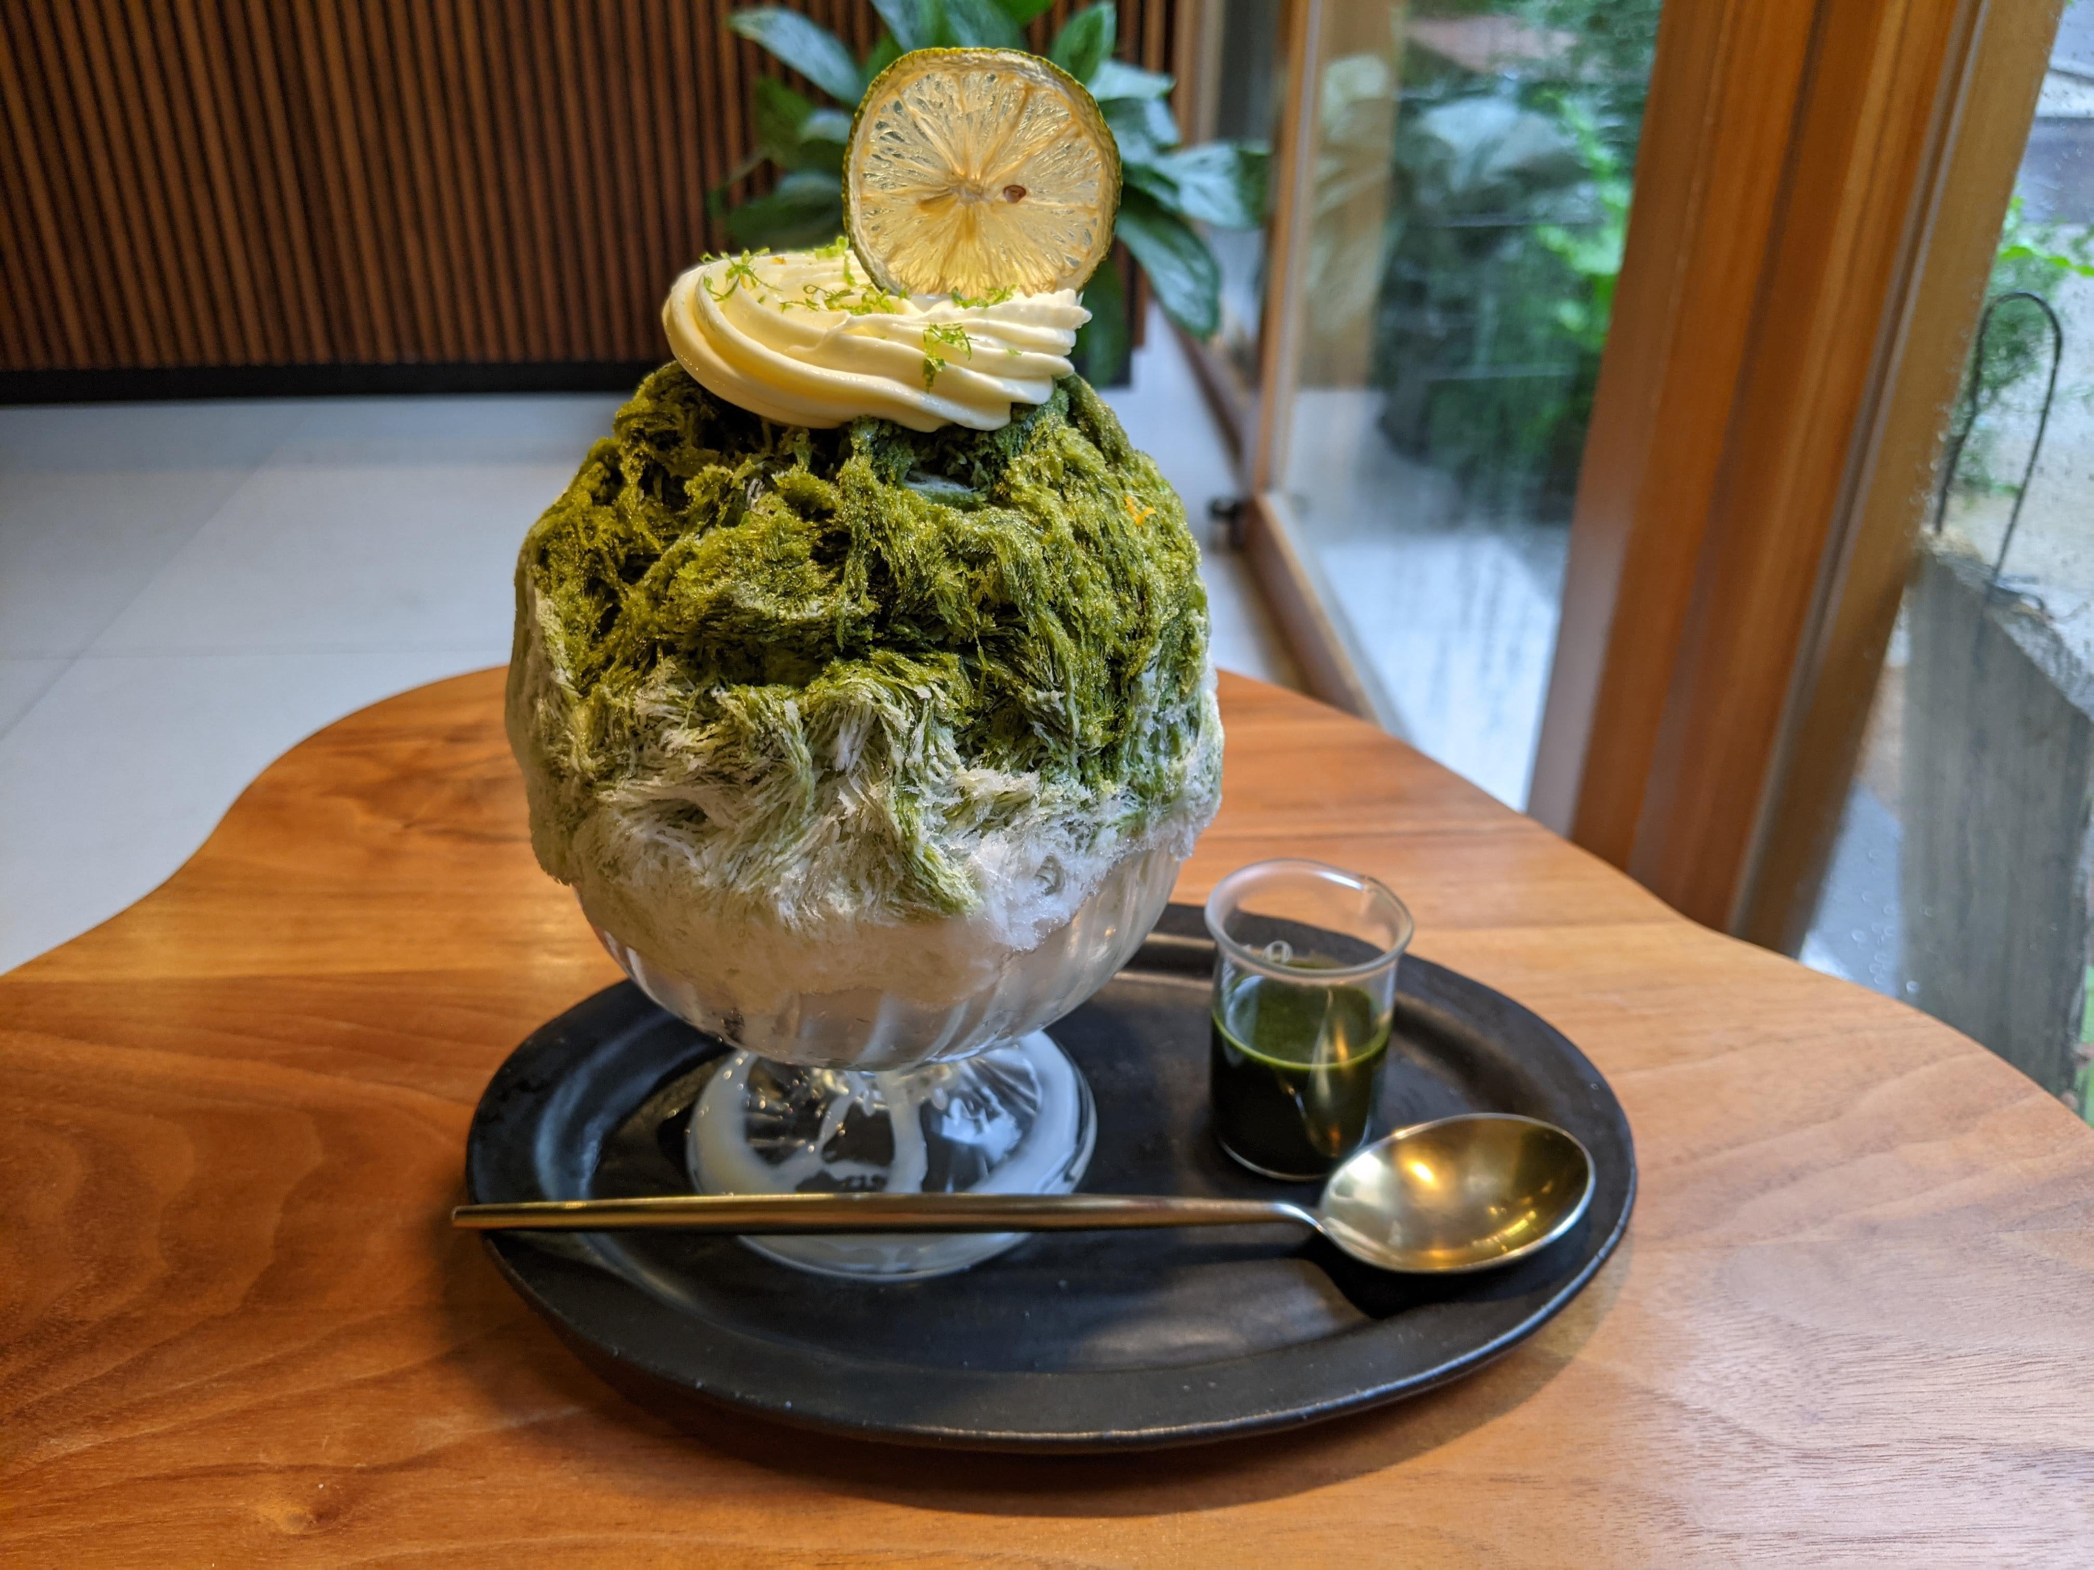
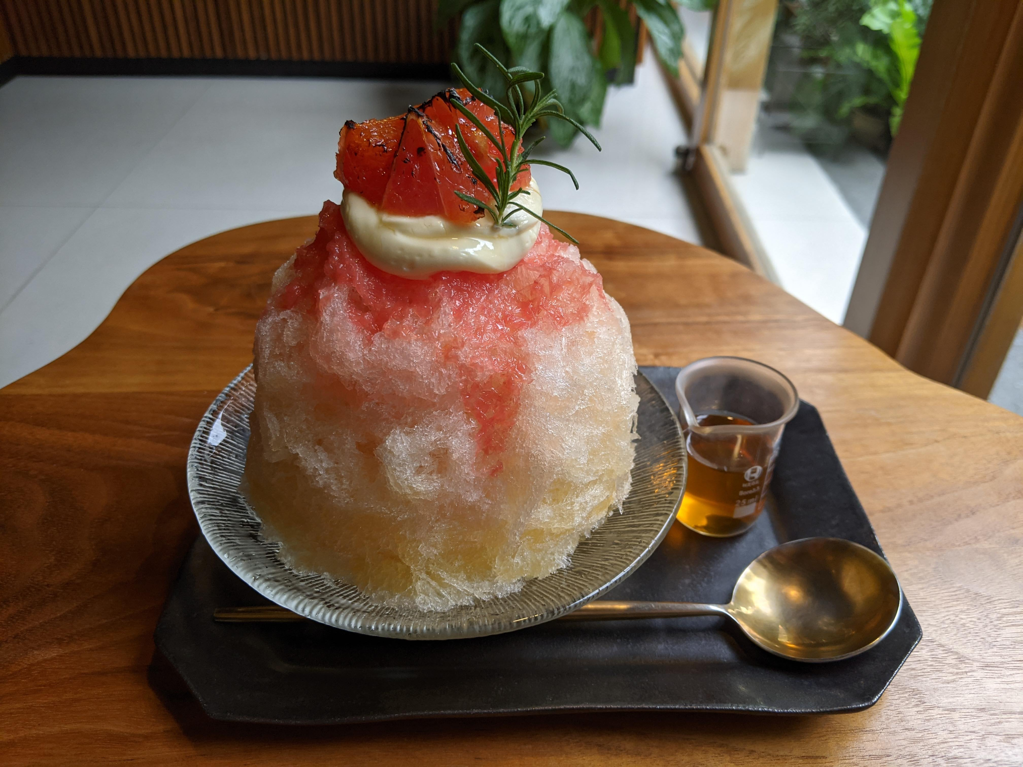
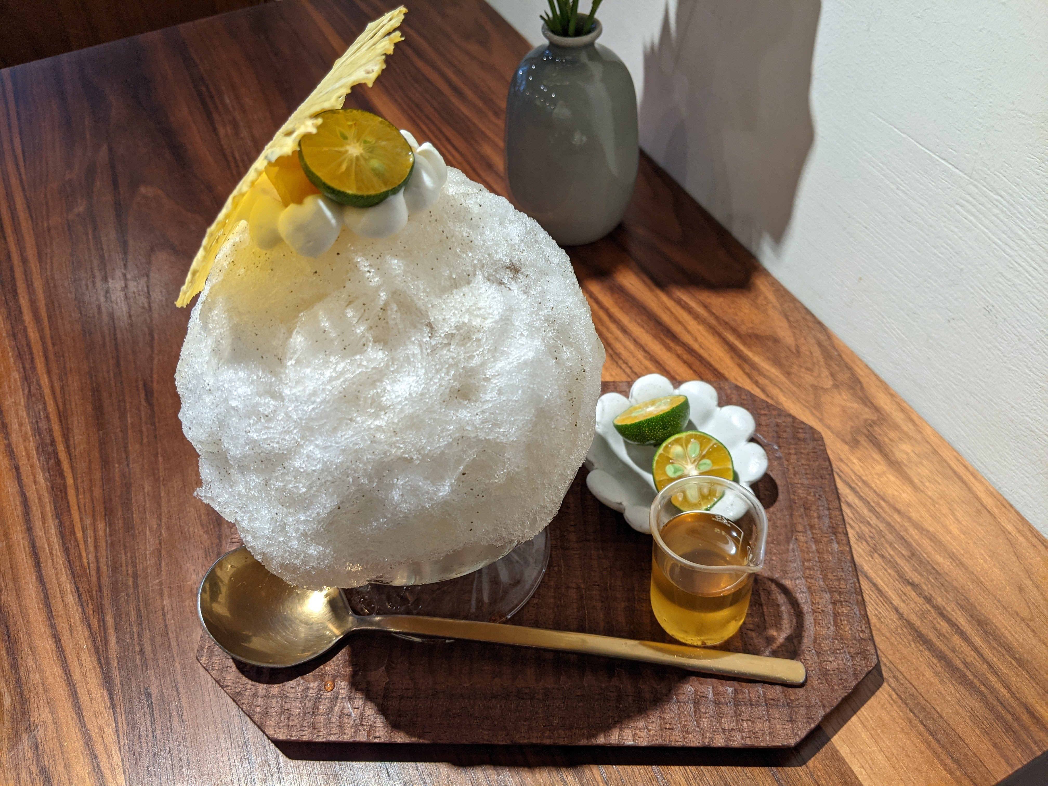
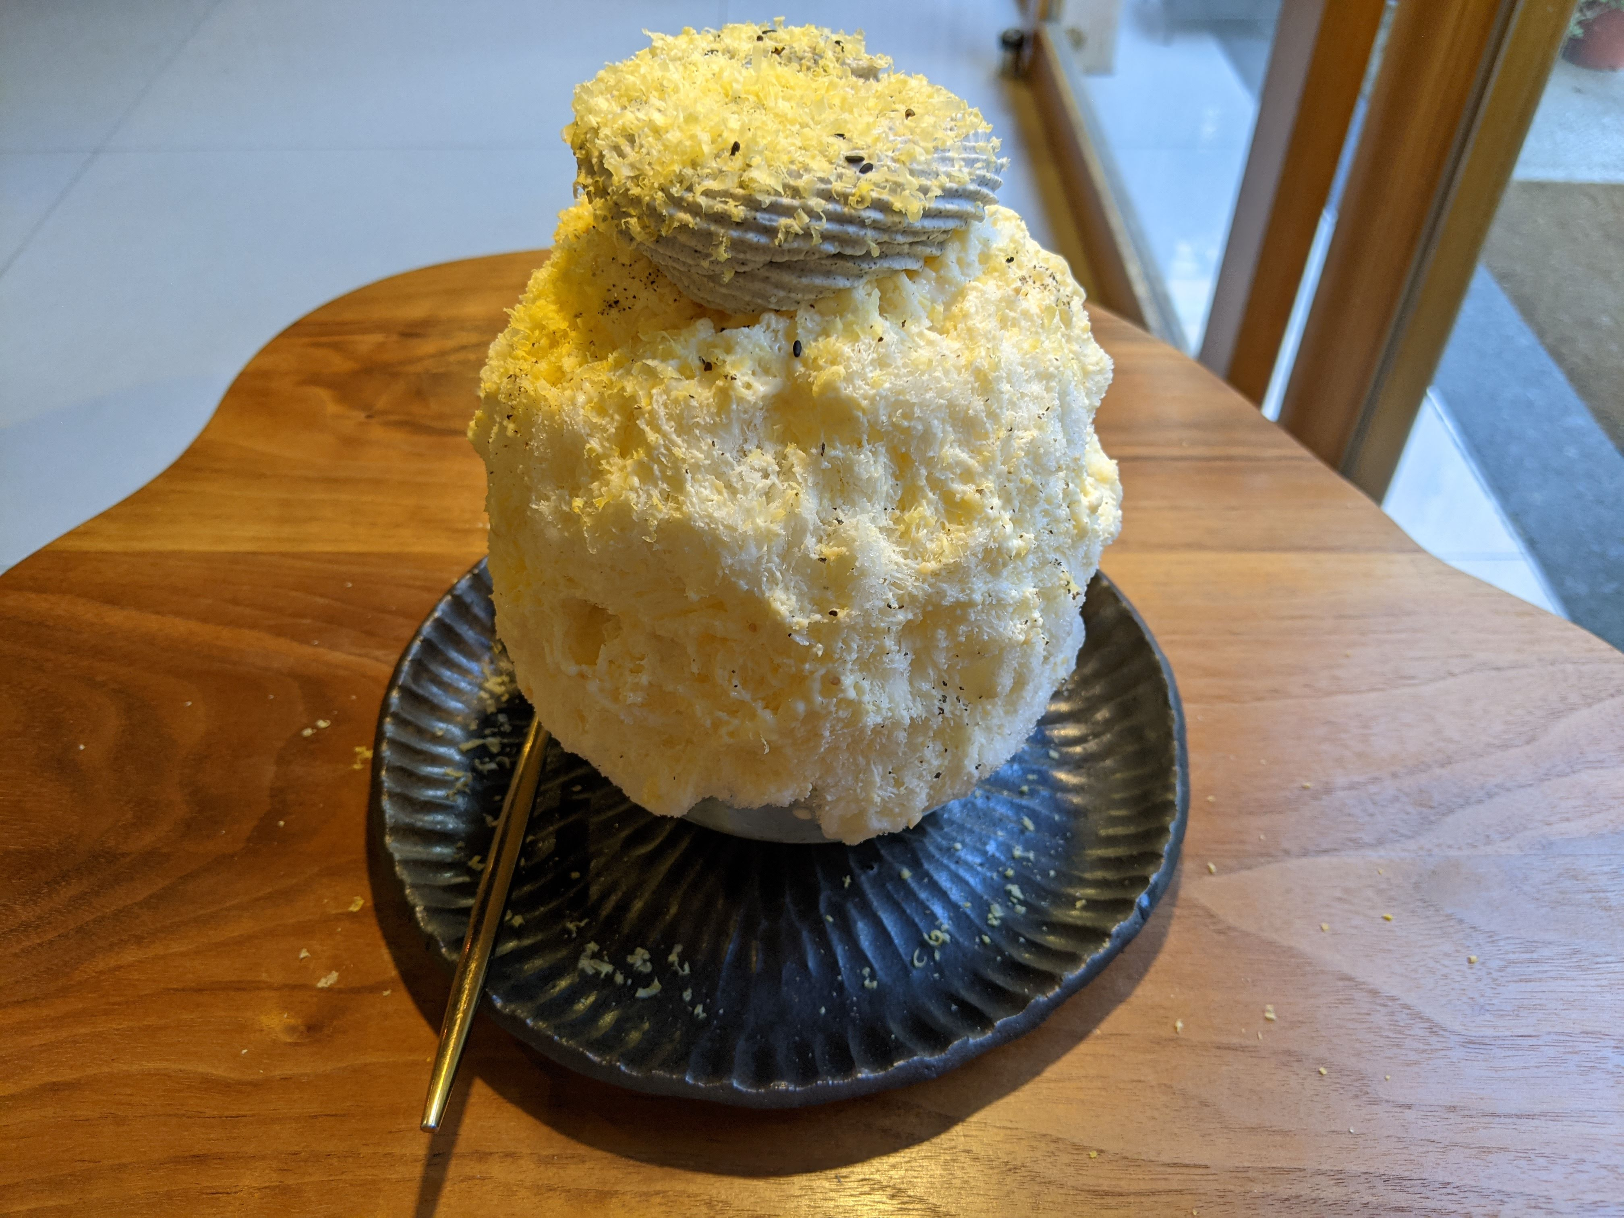

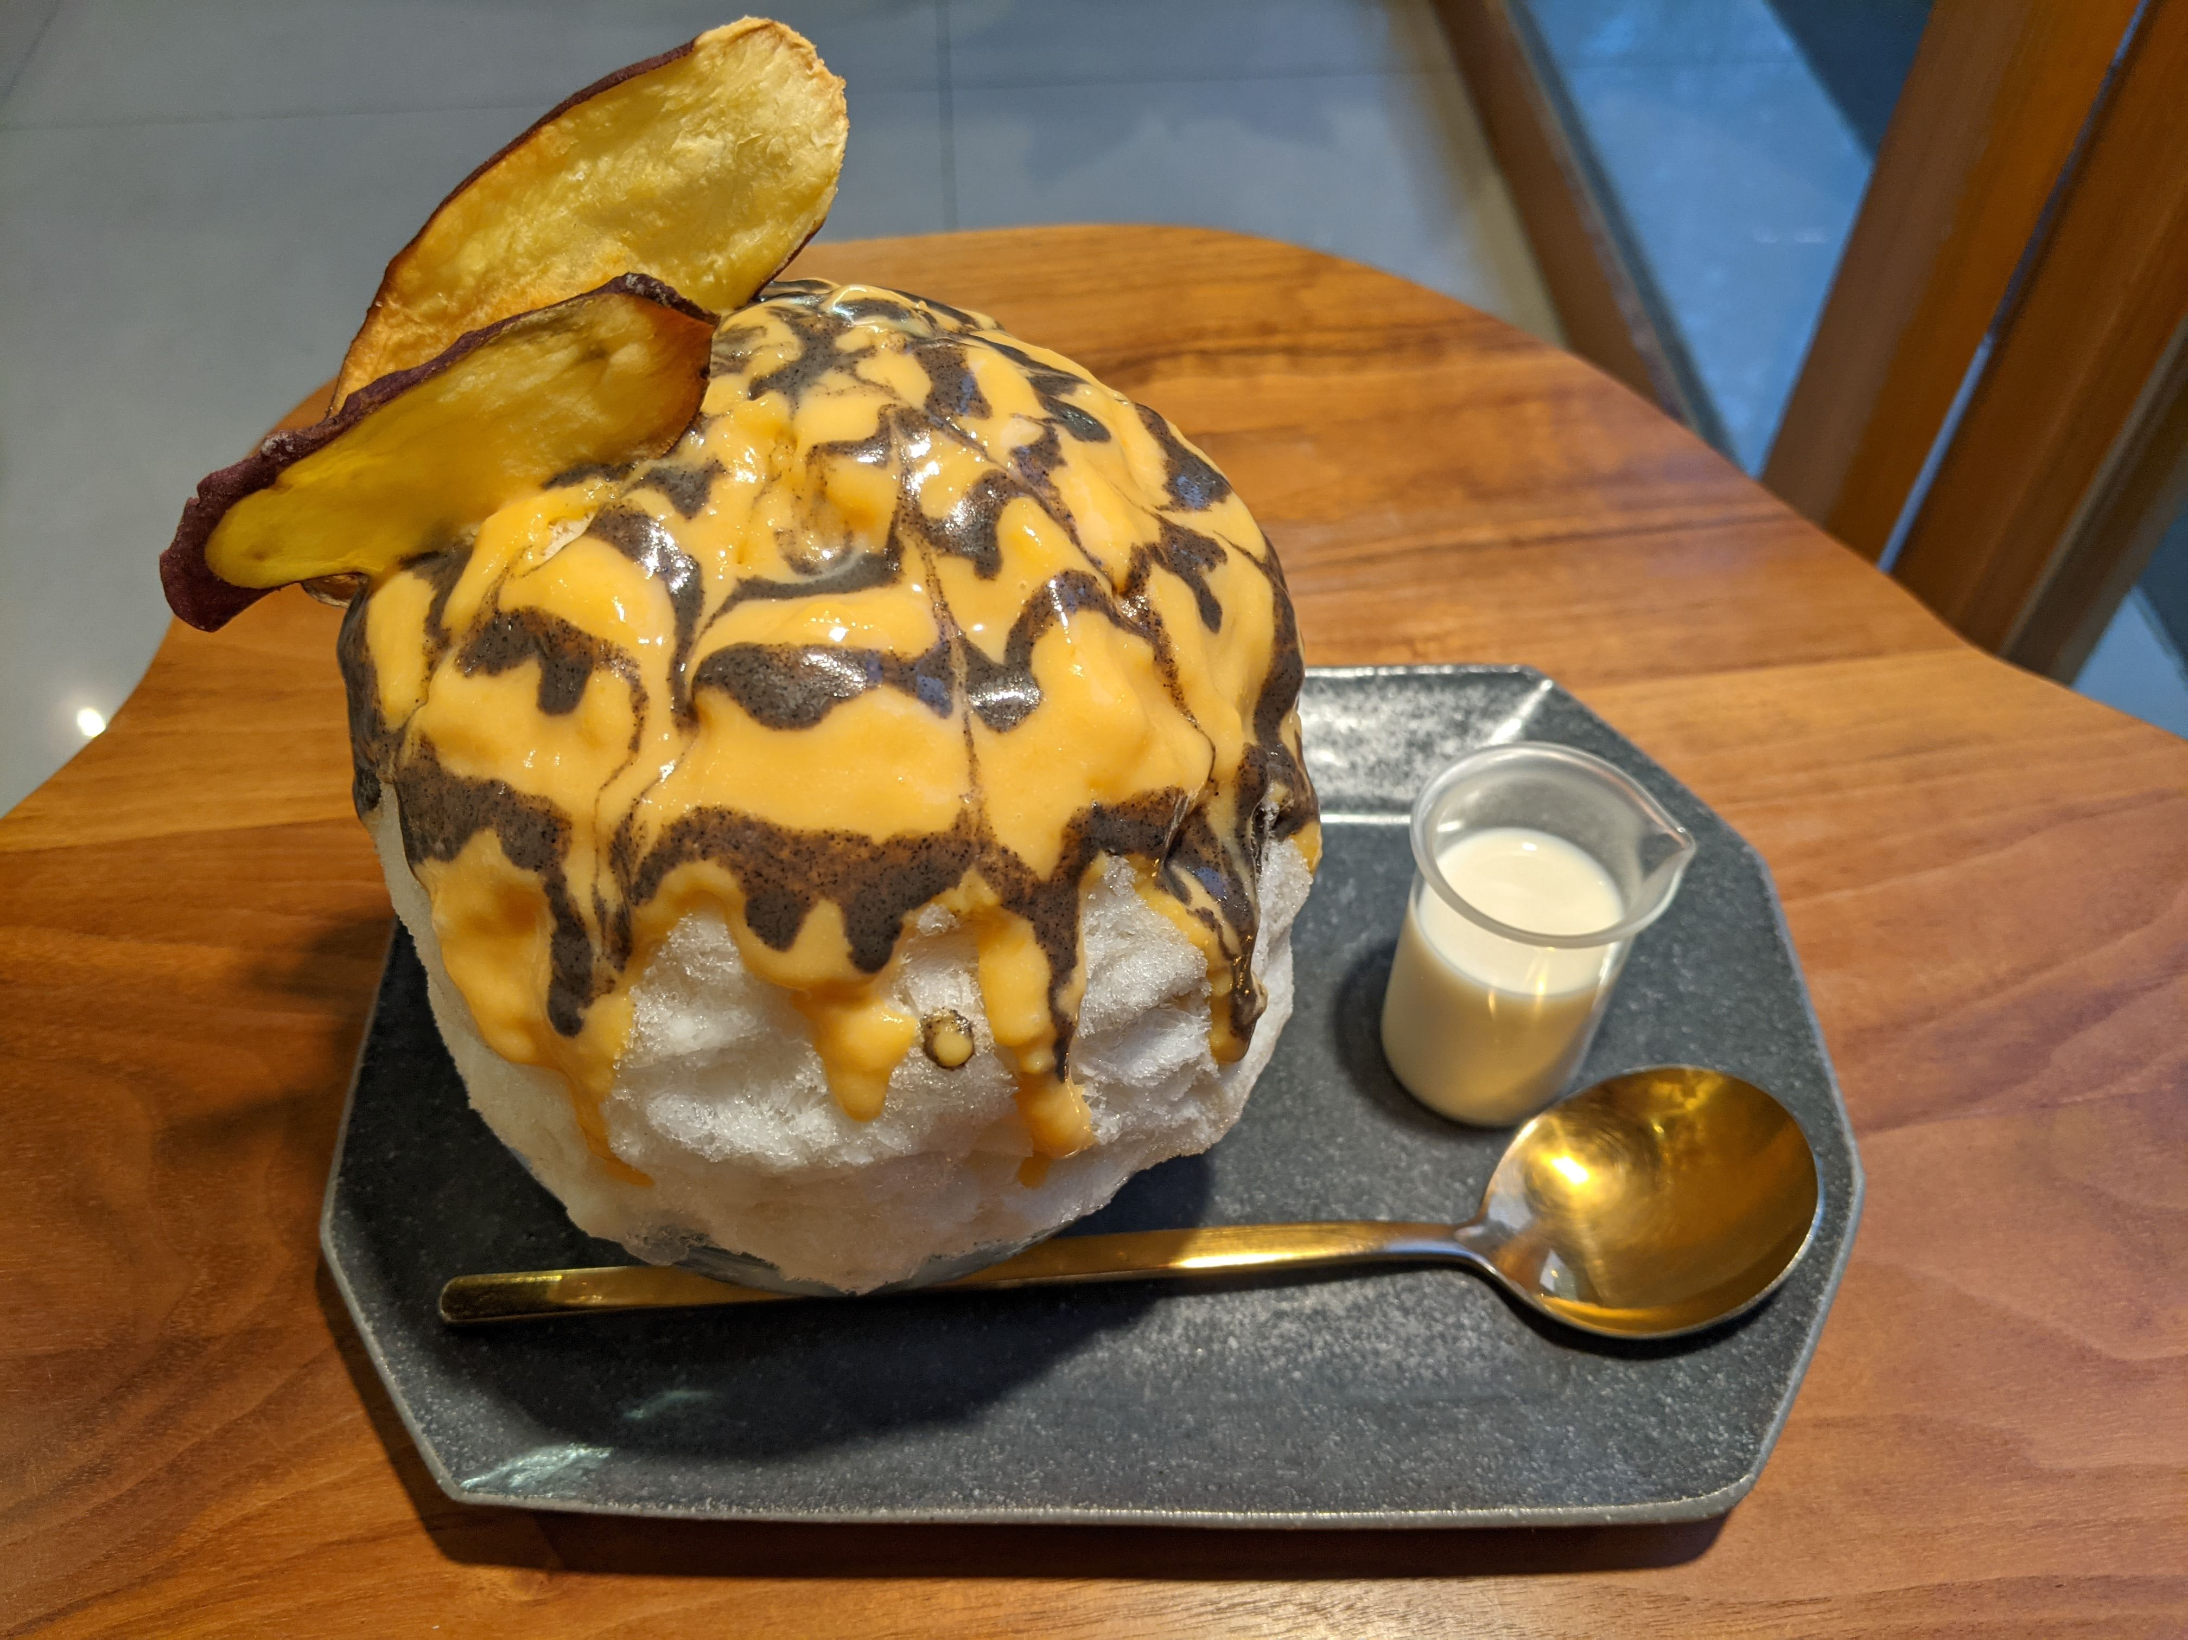



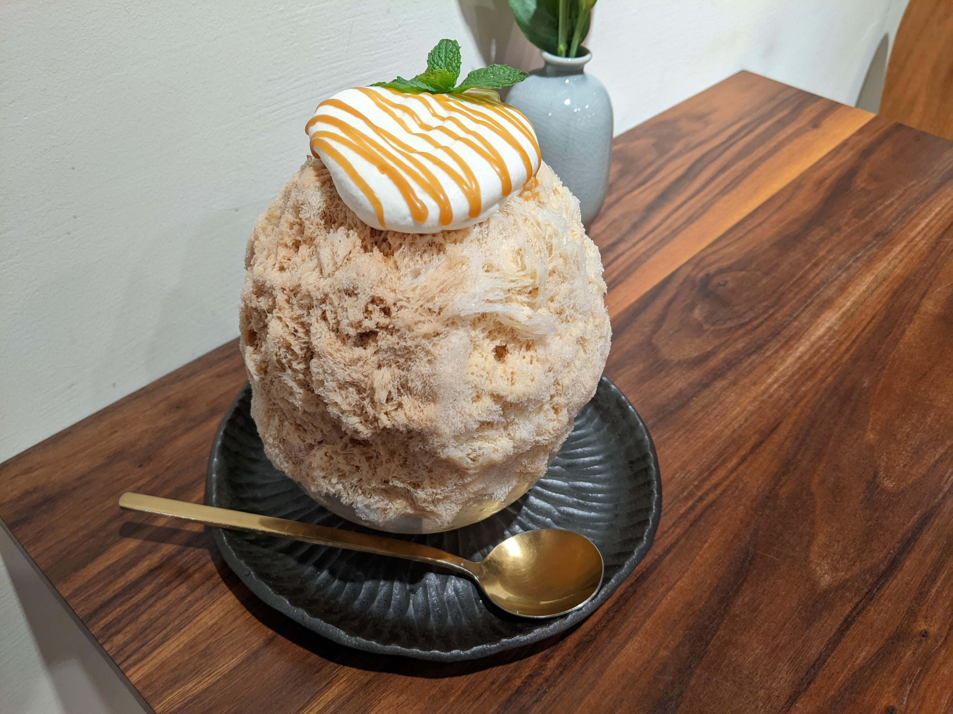
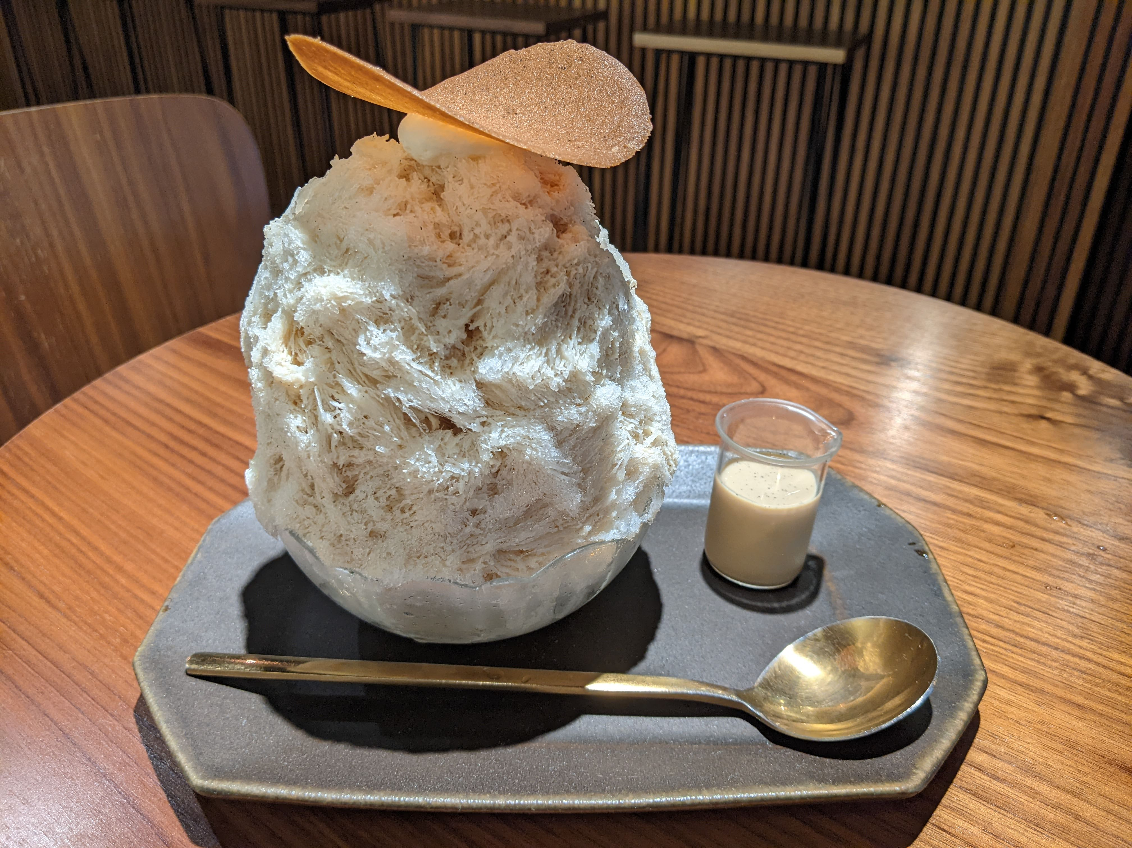
Food
Dessert, especially ice desserts

Slide 4



Smiles
Biking
K-POP
Traveling

Slide 5
Project
Topic : Predicting health risk score by modeling urban air quality (using ML)
Dataset : Urban Air Quality and Health Impact Analysis (Kaggle)
(https://www.kaggle.com/datasets/abdullah0a/urban-air-quality-and-health-impact-dataset)

